Slide 1
Lab 9
Non-preemptive Shortest Job First (SJF) - Mira Preemptive Shortest Job First (SRTF) - Mira Round Robin (RR) - Jacqueline First Come First Served (FCFS) - Jacqueline Multilevel Feedback Queue (MLFQ) - Ahmed

Slide 2
Process Struct
int arrivalTime; // when process arrives at the queue
int cpuBurst; //cpu cyles
int priority;
int startTime; // when process starts execution
int completionTime; // when process finishes execution
int remainingTime; //remaining time from burst time (for Preemptive algorithms)
double queueTime; //for Round Robin - when the processes is pushed back in the queue
int turnAroundTime; //completionTime - arrivalTime
int responseTime; // startTime - arrivalTime
int waitingTime; // turnAroundTime - cpuBurst

Slide 3
Optimization Criteria
Turnaround time = Completion time - Arrival time
Waiting time = Turnaround time - CPU Burst time
Response time = Start time - Arrival time

Slide 4
Non-preemptive Shortest Job First (SJF)
for (int num = 0; num < myProc.size(); ++num) { //while there are ready/runable processes
execProc = minBurst()
execProc.startTime = clk //start time
clk = clk + execProc.cpuBurst //editing the clk
execProc.completionTime = clk //the finishing time
execProc.turnAroundTime = execProc.completionTime - execProc.arrivalTime
execProc.responseTime = execProc.startTime - execProc.arrivalTime
execProc.waitingTime = execProc.turnAroundTime - execProc.cpuBurst
execProc.cpuBurst = 0

Slide 5
Preemptive Shortest Job First (SRTF)
int burst0 = 0;
while (burst0 < myProc.size()) { //while there are unfinished proc -- burst != 0
execProc = minRemaining()
//Process not yet started
if (cpuBurst == remainingTime)
execProc.startTime = clk //Assigning a start time
//once picked --> decrement the remaining time
execProc.remainingTime--
//Process finished:
if (myProc[execProc].remainingTime == 0) {
execProc.completionTime = clk //the finishing time
execProc.turnAroundTime = execProc.completionTime - execProc.arrivalTime
execProc.waitingTime = execProc.turnAroundTime - execProc.cpuBurst
execProc.responseTime = execProc.startTime - execProc.arrivalTime
burst0++
clk++

Slide 6
First Come First Served (FCFS)
int FCFS::firstArrival()
{
// loops over all processes in the vector and checks to finds the one that arrived first by checking the arrival time of each process.
}
for(int num = 0 ;num < myProc.size(); num++) //while there are runnable proceses
{
int i = firstArrival(); // find process that arrived first
myProc[i].startTime = clk; // save its start time as the time of the current clk
clk += myProc[i].cpuBurst; // add to clock the cpu burst of the chosen process
myProc[i].responseTime = myProc[i].startTime - myProc[i].arrivalTime;
myProc[i].completionTime = myProc[i].startTime + myProc[i].cpuBurst;
myProc[i].turnAroundTime = myProc[i].completionTime - myProc[i].arrivalTime;
myProc[i].waitingTime = myProc[i].turnAroundTime - myProc[i].cpuBurst;
myProc[i].remainingTime = 0; // set cpu burst= 0 to indicate that the process has finished execution so as if it's no longer in the vector.
}

Slide 7
Round Robin (RR)
int i = firstArrival(); //pick process that arrived first
if (myProc[i].cpuBurst == myProc[i].remainingTime)//check if this is the frist time to pick this processes
myProc[i].startTime = clk; // if yes that assign its start time to the current clock
// check if remaining time < timeslic then. This means the process finished and we should update its values.
if(myProc[i].remainingTime <= timeslice)
{
clk += myProc[i].remainingTime;
myProc[i].completionTime = clk;
myProc[i].turnAroundTime = myProc[i].completionTime - myProc[i].arrivalTime;
myProc[i].waitingTime = myProc[i].turnAroundTime - myProc[i].cpuBurst;
myProc[i].responseTime = myProc[i].startTime - myProc[i].arrivalTime;
myProc[i].remainingTime = 0;
num++;
}
// else - means the process still didn't finish
else{
clk += timeslice;
myProc[i].remainingTime = myProc[i].remainingTime - timeslice; // subtract from the remaiinng time the timeslice which is how long the process has been runnig
myProc[i].queueTime = clk + 0.5; // put the process at the end of the queue
}

Slide 8
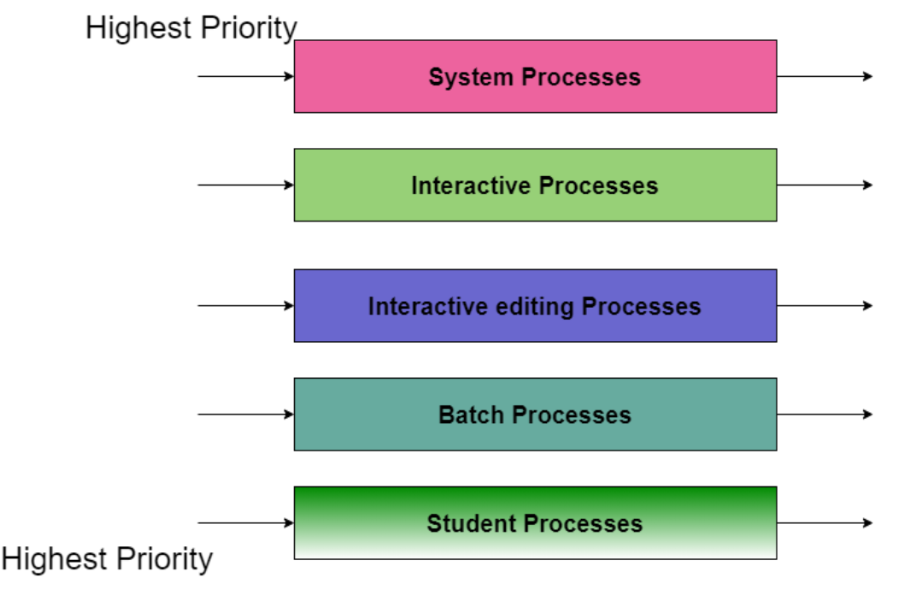
Multilevel Feedback Queue (MLFQ) - Ahmed
Queues are scheduled by the their different priority depending on their types.
As an example foreground processes would have higher priority than background processes.
Each queue can use different scheduling algorithms for example Round Robin for foreground and FCFS for background.
Another example can be seen in the figure where student processes queue take the least priority however within each queue there’s also order by priority.
This means that no batch process would run unless all the above processes are done

Slide 9
Multilevel Queue (MLQ)
while(num < myProc.size())
{
highestPriority = maxP(myProc);
constructMaxQ();
int i = firstArrival();
if (myProc[i].cpuBurst == myProc[i].remainingTime)
myProc[i].startTime = clk;
if(myProc[i].remainingTime <= timeslice){
clk += myProc[i].remainingTime;
myProc[i].completionTime = clk;
myProc[i].turnAroundTime = myProc[i].completionTime - myProc[i].arrivalTime;
myProc[i].waitingTime = myProc[i].turnAroundTime - myProc[i].cpuBurst;
myProc[i].responseTime = myProc[i].startTime - myProc[i].arrivalTime;
myProc[i].remainingTime = 0;
num++;
}
else{
clk += timeslice;
myProc[i].remainingTime = myProc[i].remainingTime - timeslice;
myProc[i].queueTime = clk + 0.5;
}
}
Find the value of the highest priority from the list of processes and save it in a variable.
Loop over all processes and check if this process which is to be picked has priority = highest priority, if yes, then this process is picked for execution.

Slide 10
Assumptions & Testing
All processes entered are runnable processes.
All arrival timings, burst time and priorities are integers
All algorithms are implemented as classes where each class is supported by the private data members and functions needed by this algorithm.
A vector of processes is passed to each class to perform the logic.
This vector is initialized randomly by random arrival time, cpu burst time and priorities.
The arrival time ranges from 0 to 120 seconds, burst time ranges from 1 to 30 and priority ranges from 0 to 2.

Slide 11
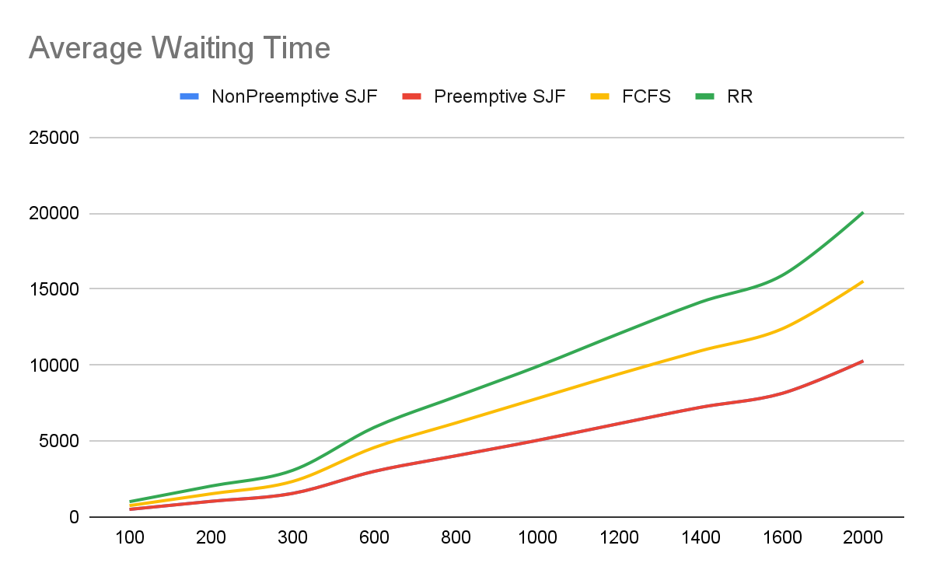
Waiting time for RR is longest because
although processes are regularly being picked for execution, they go in round robin, so once a process is picked and finishes its timeslice, it has to wait for all other processes to be picked first, before it can be picked again. This increases the waiting time.
Waiting time for shortest job first is shortest because it always picks the processes that have the shortest cpu burst which end up finishing quickly and thus reducing the waiting time for the rest of the processes, if a long process has been picked.
Waiting time is average for FCFS because although once a process starts executing it must finish and thus it is not interrupted in the middle so there is not waiting time in the middle, however, there could be a high waiting time before the process starts, due to a long process benign picked first.

Slide 12
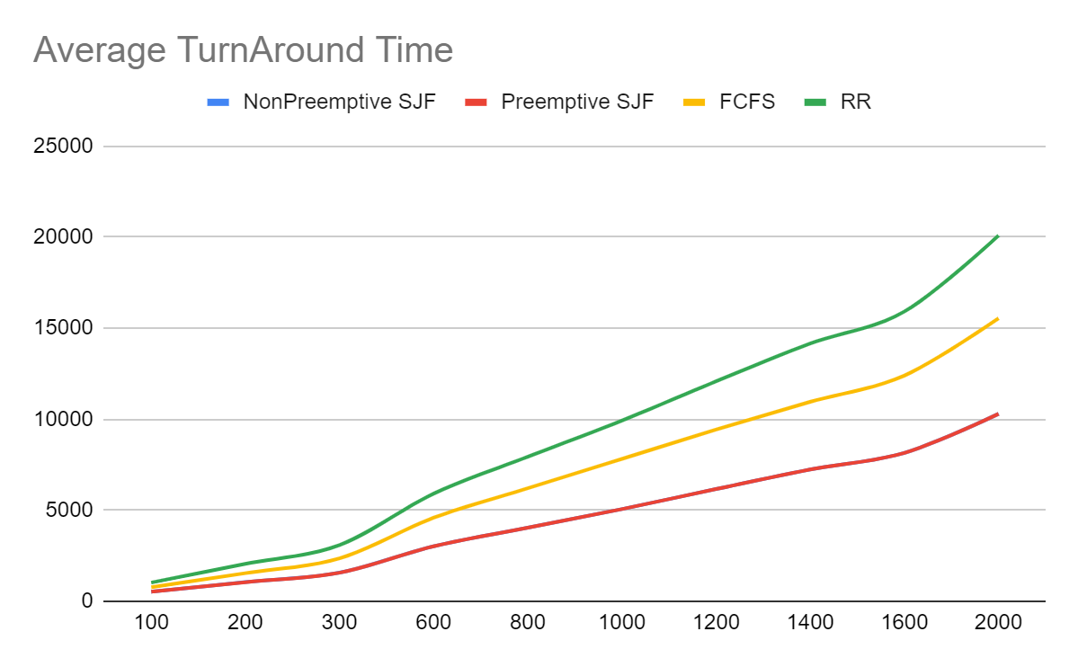
Turnaround time is the time it takes for a process to complete execution from the time of its arrival.
The turnaround time is least for shortest job first because it picks the process with the smallest cpu burst which is likely to have a small turnaround time. So it picks a process and either finishes it or even if it’s preempted it is more likely to get picked back soon, since its remaining time is decreasing
RR has highest turnaround time because a specific timeslice is given for each process Thus from arrival time to completion might be long, because if a process doesn’t finish during the given timeslice it is put at the end of the queue and is only picked again when all processes have a their cpu timeslice, which could be after a long time.
Turnaround time for FCFS is better because although once a process arrives it is picked to run, since the many processes could arrive while one long processes is rrunnign so the time between when it arrives and when it actually starts execution (response time) is long and thus increases the turnaround time

Slide 13
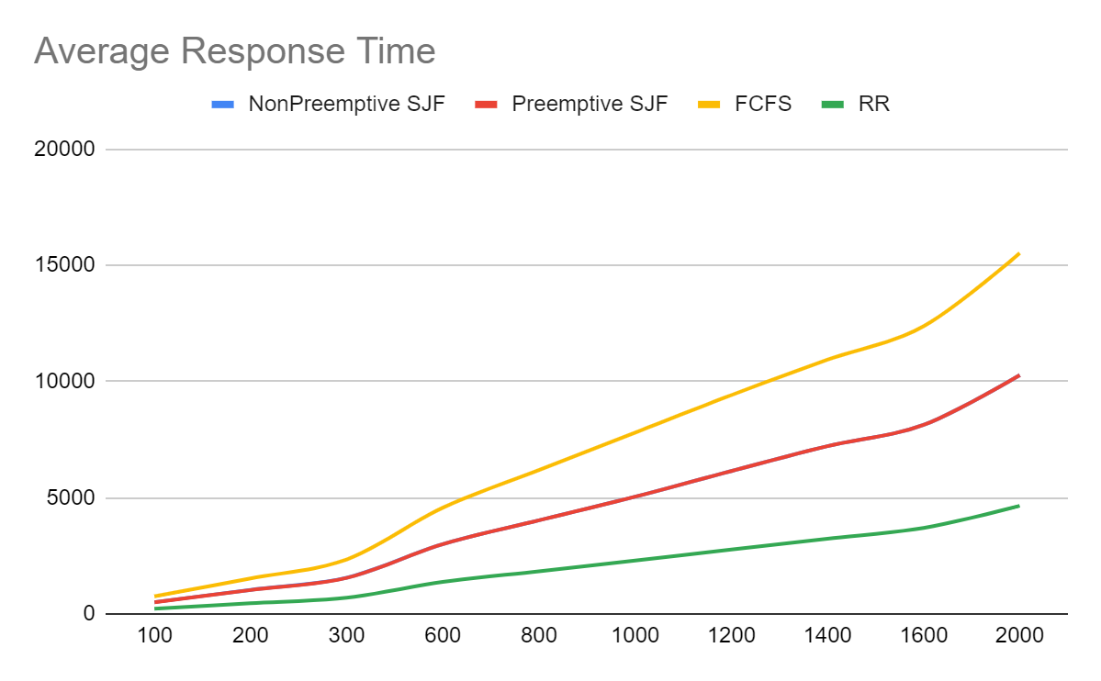
Response Time is lowest for RR because RR gives each process a timeslice, and once the timeslice expires, it picks another process. Thus the likelihood, that a process will arrive and not be picked is at most equal to the timeslice.
It is highest for the FCFS because a the first process that could be picked could be a very long process and thus it results in the convoy effect, where all other process are waiting for this big process to finish.
For shortest job first, the waiting time is better than FCFS because processes that are shortest are picked first and thus other processes will not have to wait a long time until they have the chance at being picked.

